Slide 1


HIT — Machine Learning Course | Final Project
Kaggle IEEE-CIS Competition
Vesta Corporation Dataset
Irena Shtelman Kravitz
MSc. in Data Science student at HIT
GitHub: github.com/irishask/ML_Fraud_detection
March 2026

Slide 2

Project Goal & Statement
Project Goal
Predict the probability that an online transaction is fraudulent, enabling real-time fraud prevention that protects both consumers and businesses from financial loss while minimizing false positives that block legitimate purchases.
Problem Statement
Online payment fraud exploits stolen cards and identity theft to make unauthorized purchases before detection. The task: given a real e-commerce transaction, predict the probability it is fraudulent.
What makes it hard:
3.5% fraud rate — standard accuracy is meaningless; PR AUC required
Temporal structure — fraud patterns evolve; random splits leak future data
339 anonymous V-columns — strong signal, zero interpretability; improvement must come from behavioral engineering
No UserID — user identity must be reconstructed; a core design decision with direct metric impact

Slide 3

Class Imbalance & Dataset
Class Imbalance
Statistical baseline: predict everything as legitimate → 96.5% accuracy, 0% fraud caught.
Dataset
Source | Kaggle IEEE-CIS / Vesta Corporation
Size | 590,540 transactions · ~6 months
Features | 434 raw + 24 engineered = 458 total
Split | 60% train / 20% val / 20% test — time-based (3-way split)
Metric | ROC AUC (official) + PR AUC
Metrics
ROC AUC — Kaggle's official metric. Ranks fraud above legitimate across all thresholds.
PR AUC — with 3.5% fraud, high ROC AUC can still miss most fraud cases. PR AUC exposes this.
Accuracy — is not an appropriate metric under severe class imbalance (a model predicting "legitimate" for every transaction scores 96.5% while catching zero fraud).

Slide 4

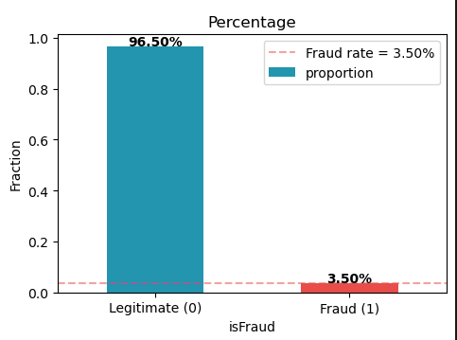
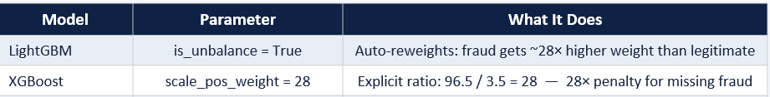
Handling Class Imbalance - chosen Approach
Rejected Techniques
❌SMOTE (generates synthetic fraud samples by interpolating between real ones )
Synthetic patterns may not reflect real fraud, degrades model on actual data
❌Undersampling
Discards 80%+ of real legitimate transactions to balance classes — massive, unacceptable information loss
Chosen Approach - Native Class Weights in Each Model
✅ No synthetic data, no data loss, all real transactions preserved.
✅ Each model natively penalizes missed fraud more than false alarms.

Slide 5


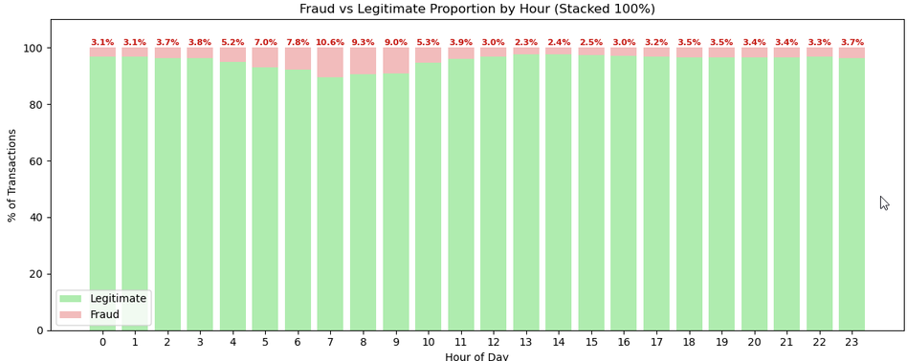
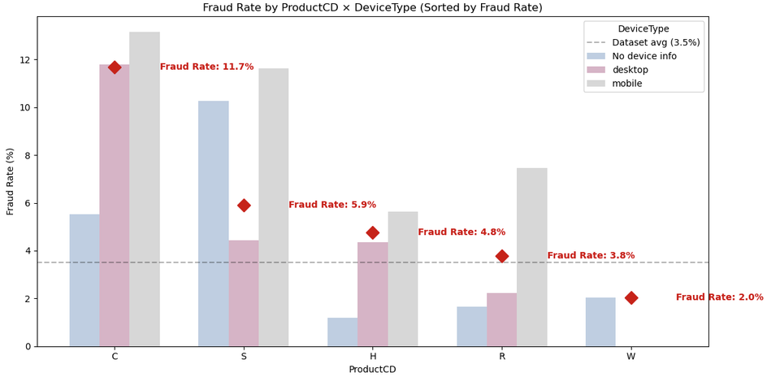
EDA — Key Discoveries
Fraud rate peaks at night hours 5–9 AM (~3 × average)
Legitimate users inactive — fraudsters exploit low-monitoring windows
Mobile fraud rate: 10.17% (×3 average)
Fraudsters use card immediately
New recipient email: fraud lift ×1.85 ← strongest signal
New device type: fraud lift ×1.66
All web transactions arrive without device fingerprint
Fraudster uses stolen card, redirects goods to own address
Lift = group fraud rate / overall fraud rate (3.5%)
UID Grouping: {card1 + addr1} cleanly isolates individual cards

Slide 6

UniqueID
Reconstructing User Identity
The dataset has no UserID — identity must be reconstructed.
UID = card1 + addr1
card1: hashed card number
addr1: billing zip code
UID = [card1 + addr1] cleanly isolates individual cards
Why not D1? (used by many Kaggle solutions)
D1 drifts over time — it shifts as cards age, fragmenting groups
Adding D1 multiplies group count, leaving most groups with a single transaction (no history to aggregate)
UID is the foundation for all engineered features:
Aggregation features - transaction history per card
Behavioral fingerprint - spending patterns & anomalies
Product/service profile - what this card typically buys
UID was confirmed by analysis:
91.87% of UID groups (Legitimate cards) - zero fraud. Legitimate cards active for months and have many transactions per card
8.13% of UID groups (Fraud cards) - contain at least one fraud transaction. Fraud cards are blocked quickly → few transactions per card

Slide 7

Feature Engineering
(in Top 30)
Aggregation Features (transaction history per card)
tx_amt_mean/std/min/max: inconsistent amounts → card testing or abuse
tx_amt_ratio: current amount >> card's typical → anomaly
time_since_last_tx: long silence then burst → dormant card activated
delta_amt: large jump between consecutive transactions
tx_count / tx_count_last_30d: sudden high-volume activity → card just compromised
Behavioral Fingerprint (deviation from card's personal pattern)
hour_vs_typical: transaction at unusual hour for this specific card
uid_time_entropy: sudden behavioral randomness → routine broken
amt_vs_personal_median: amount far above this card's personal norm
amt_z_score: statistically extreme amount for this card
Product Profile (purchase pattern per card)
is_new_product: fraudster buys different product types than the legitimate card owner
amt_vs_product_median: current amount vs historical median for this ProductCD
No-Leakage Architecture
Production-Ready Design
Every feature uses strictly prior transactions only, the current transaction is never included.

Slide 8

Time-Based Train/Val/Test Split
The dataset spans ~6 months of real transactions.
Split respects temporal order strictly — no shuffle.
Train (60%): ~months 1–3
Validation (20%): ~month 4
Frozen Test (20%): ~months 5-6
Why not random split?
Random split:
future transactions leak into train → inflated metrics → overoptimistic estimate
Time-based split : train = past only
val = future only → unbiased estimate of production performance
Why one split — not cross-validation?
No data drift detected over 6 months — a single boundary is valid and mirrors production exactly.

Slide 9
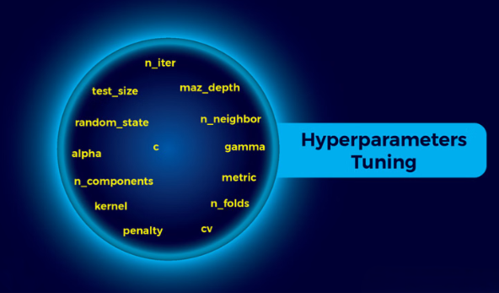
Hyperparameter Tuning with Optuna
Why Optuna?
Bayesian optimization - learns from every completed trial, focuses search on promising parameter regions.
Pruning kills unpromising trials early → finds near-optimal params in 30–100 trials.
Why not alternatives?
Grid Search: ~60K combinations → computationally impossible with CPU
Random Search: no learning between trials → does not improve over time
Quality Levels of Optuna (tuning depth control):
med_high — 75% data, ~8–10h per ML-model
Objective:
V2: maximize ROC AUC on val-set (Kaggle's official metric)
V3: maximize PR AUC (avg_precision_score) on val-set
Early stopping for hyperparameters optimization:
if val optimized metric does not improve for N rounds → trial stops early, saving time
XGBoost Feature Exposure Fix & Tuning Design:
Optimization for XGBoost:
colsample_bytree search space narrowed to force trees to sample ~20–90 columns (instead of ~180–460), giving 24 engineered features fair exposure vs 336 V-columns (anonymized proprietary features).
This is NOT needed for LightGBM that naturally get sufficient exposure by far more splits per tree.

Slide 10

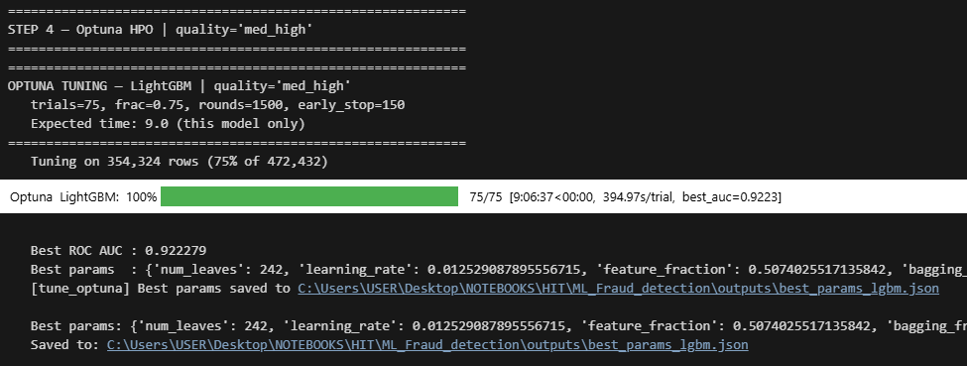

Hyperparameter Tuning with Optuna
Each model tuned independently - different hyperparameters, different sensitivities
V2:
LightGBM V2 — med_high for ROC AUC optimization (75 trials, 75% data, up to ~8-10h)
XGBoost — med_high (75 trials, 75% data, up to ~10h)
CatBoost removed from pipeline (see Experiments slide) Optuna killed after ~10h at ~50% completion
Final training always uses the full train dataset (60%) with the found parameters
V3:
LightGBM V3 — med_high for PR AUC optimization (75 trials, 75% data, PR AUC objective + instance weighting [w=1,2,3,4 by temporal chunk])

Slide 11
Ensemble VS Solo GBM Model
Results
Conclusions
XGBoost tried in multiple configurations: standalone, weighted ensemble with LightGBM, and on LightGBM's top-100 features — all below LightGBM on PR AUC
CatBoost excluded - Optuna killed after ~10h at ~50% completion
Selected:
V2 and V3 optimized on different objectives (partially uncorrelated errors)
Averaging is effective (Ensemble V2 + V3)
Model | Val ROC | Val PR | Test ROC | Test PR
V2: LightGBM (ROC AUC objective) | 0.9327 | 0.6281 | 0.8974 | 0.5087
V3: LightGBM (PR AUC + weights) | 0.9241 | 0.6470 | 0.8904 | 0.5142
★ Final: Ensemble (AVG) V2 + V3 | 0.9342 | 0.6440 | 0.8990 | 0.5178
Statistical baseline:
predict everything as legitimate → 96.5% accuracy,
PR AUC = 0.035 (3.5% fraud rate)
Ensemble V2+V3:
Test PR AUC = 0.5178
Improvement = 0.5178 / 0.035 = ~14.8x

Slide 12
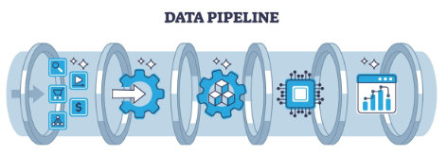
Pipeline Summary
EDA:
fraud patterns & key discoveries
2. UniqueID construction:
UID = [card1 + addr1]
3. Feature Engineering (24 features) - each transaction enriched with historical data from prior transactions only → no leakage guarantee
aggregations
behavioral fingerprint
product profile
4. Time-Based Split (60% train/ 20% val /20% frozen test):
no shuffle
no leakage
5. Optuna Tuning with early stop (by selected metrica)
independent per model
V2: ROC AUC objective
V3: PR AUC objective + instance weighting
6. Ensemble implementation
Average between V2 LightGBM &V3 LightGBM
7. Final selection - Ensemble V2+V3
Test ROC = 0.8990
Test PR = 0.5178

Slide 13

Kaggle Leaderboard Context &
Why Top Solutions Scored Higher
Technique | Why top solutions used it | Why we couldn't / didn't
Full CatBoost Optuna tuning | Adds genuine architectural diversity to ensemble | ~17h/trial on CPU — infeasible. Default params below LightGBM.
XGBoost + LightGBM + CatBoost ensemble | Three architecturally different models, uncorrelated errors | CatBoost excluded — see above. XGBoost alone below LightGBM on PR AUC.
100s of feature iterations | GPU → train+evaluate in minutes → rapid exploration | Each iteration hours on CPU → only 5–10 experiments feasible
UID anchor (TransactionDT − D1) | Adds aggregation features on finer sub-groups | Tested in EDA: ×5.3 group fragmentation, fraud purity drops. Not viable as UID replacement.
Feature selection (V-columns) | Reduce noise, speed up training | V-columns anonymous — LightGBM handles selection implicitly. Manual removal risks discarding valid signal.
My Final chose: Ensemble V2+V3
Test ROC 0.8990 → comparable to top 20% of 6,381 teams.
Note: direct comparison is approximate — different test periods.

Slide 14

Future Improvements
CatBoost with GPU
MLP (Neural Network) with GPU
learns non-linear boundaries fundamentally different from tree-based models
Isolation Forest as meta-feature
unsupervised anomaly score added as input to selected ML-model
captures structural unusualness independently of fraud label
Target Encoding (card1, addr1, P_emaildomain)
leave-one-out target encoding for card1, addr1, P_emaildomain
requires careful OOF implementation — added complexity on CPU each experiment takes long hours/days

Slide 15


